Slide 1
Enterprise and Innovation (and bit about how to get a job)
Phil Clipsham
November 2015

Slide 2
Phil Clipsham
Previously – Head of Department, Computing & Information Systems
Now – Director, Greenwich Bright
Also – Technical Director of a health software company

Slide 3



Slide 4
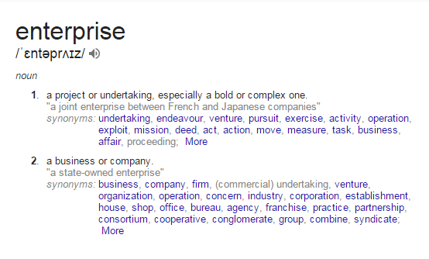
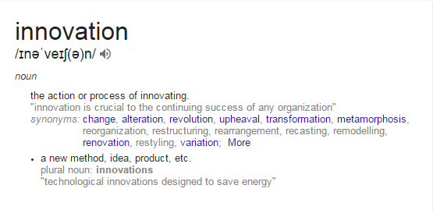
Definitions: Enterprise and Innovation

Slide 5
You need to be both…
Enterprising
and
Innovative

Slide 6
4 IMPORTANT QUESTIONS
Why are you studying this degree?
What job / career would you like?
Do you know how you will get there?
Do you know what support you will need from us to help you?

Slide 7
Software development
DB design / management
UI/UX Design
Data analysis / Big Data
IT Technician
Games Developer
Web Development
IT Security
Business analysis
Geographical Information Systems
Technical Author
IT Governance
Something else…
WHERE?
a large multinational company
an SME
a microbusiness
yourself
something else?
WHAT?

Slide 8
HOW?
So, what makes you think that someone will give you a job?
As an employer, I am looking for:
Good technical skills
Ability to communicate
In writing
Spoken
Talking to clients
Understanding of business pressures as well as technical needs
Someone who can present themselves appropriately
Study hard – you need technical skills
Develop personal skills – you need to know how to communicate
Get work experience – which is related to your studies
Volunteer
Internships
Industrial placement
Industry based projects
Manage your personal image – how you are perceived is important

Slide 9
How we are helping you
This course!
Preparing your image – your CV, how you apply for jobs, social networks, etc.
Industrial placement year
Industry based projects
Mentoring
Greenwich Bright / GWizards

Slide 10

How
GWizards
UNIVERSITY
works
work experience
student projects
CIS Students
short courses & training
development
STUDENT
design
mentoring
entrepreneurial
Support when working with clients
LOCAL BUSINESS
COMMUNITY GROUPS

Slide 11
What Greenwich Bright Does
Developing Enterprise Projects
Mentoring to staff and students
Advertising the University and our services to the world
Creating enterprise opportunities for staff and students with local businesses
Managing relationships with outside organisations
Managing projects and liaising with University offices
Developing content and support for courses
Managing Short Courses and Events
Costing, Resourcing, sending invites, etc.
Running of events
Supporting Entrepreneurial work
Support for bidding for enterprise funding
Supporting student entrepreneurship / start-ups
Good Food in Greenwich
Charlton Athletic FC
Virtual Law Centre
South East Enterprise
Health App
London Digital Security Centre
Creating simple process to manage short courses and events
Mentoring student start up companies

Slide 12

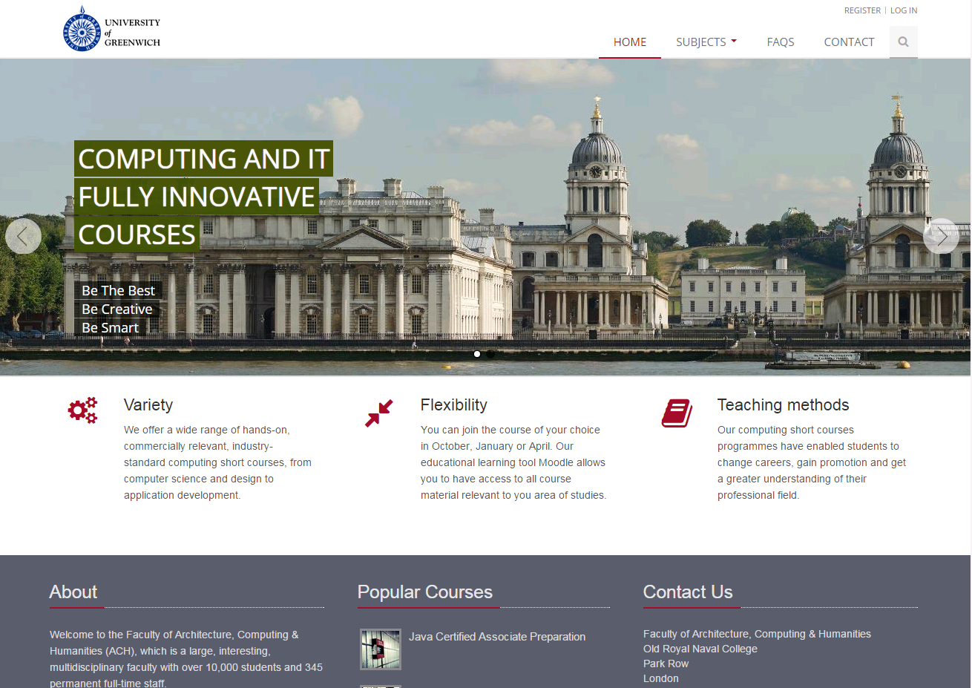
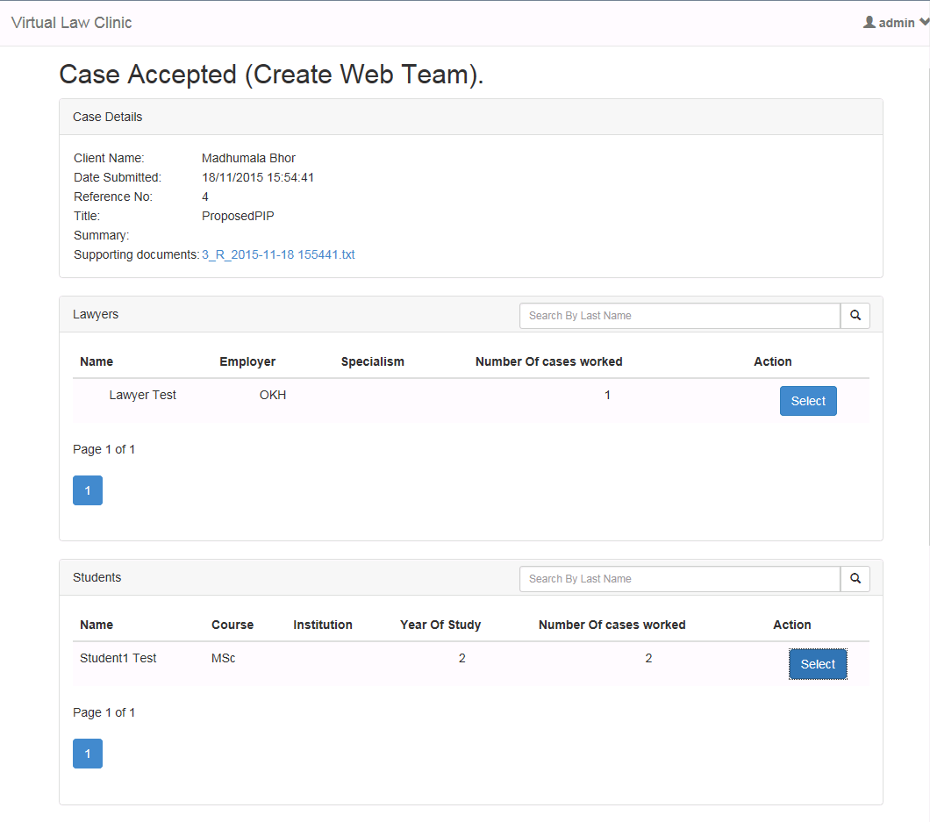

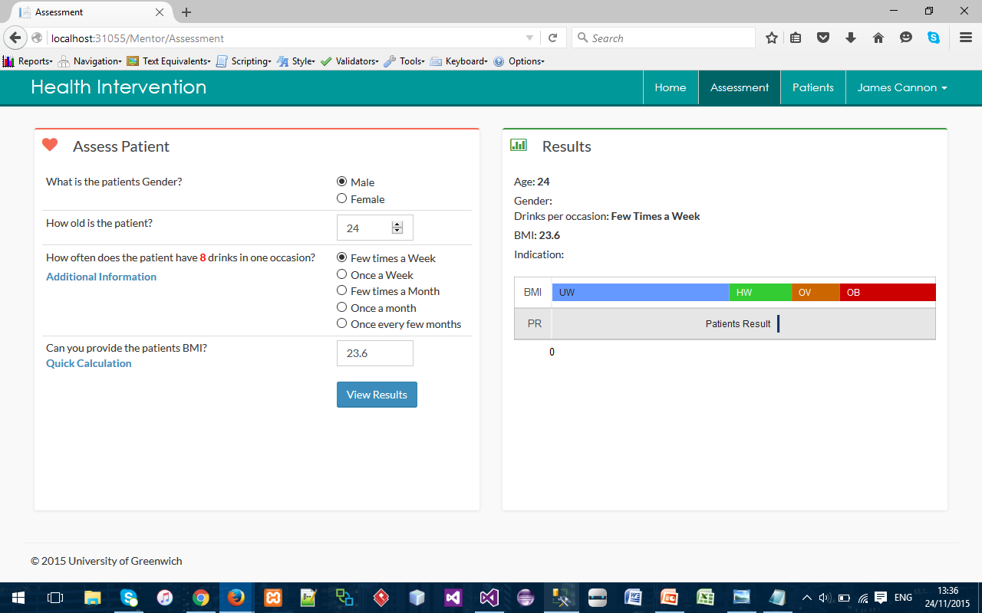

Slide 13
Have you got a good idea?
Most good ideas are just that, a good idea (but not good as a commercial possibility)
You need to find out the following:
What is your idea?
What else is the same, similar, a competitor?
Who will buy your product / service?
Where is your marketplace and how will you carry out marketing?
Where will money come from? Set up / running costs / price point
Then write a business plan – more on this next year

Slide 14
Want to know more?
Contact us:
bright@gre.ac.uk

